Slide 1

01 / 35
DiDi
Weekly Performance Report
CX Service Operations · Delivery LOB · Phone and Live Chat
Deliverable 2: CX Quality Analyst business case
1–31 May 2026 · W19–W22
MX · CO · CR · PE
Prepared for CX Leadership

Slide 2
DiDi
Scope, data and assumptions
02 / 35
Data governance, processing methodology, and structural scope boundary conditions.
Source
Grain: one row is…
Volume
Period
What it answers
QA audits
One audited interaction
2,460
4–29 May
QA score, attribute defects, channel
QA attribute fails
One failed attribute in an audit
518
4–29 May
Pareto of defects, critical vs non-critical
CSAT surveys
One survey answer
77,266
1–31 May
CSAT %, star rating mix, verbatim comments
Recontact
One contact-reason / channel / day
994,591
1–31 May
Recontact rate, repeat volume by reason
How we treated the data
Scope & Limitations
N/A Logic Exclusions: Non-applicable attributes (Value 2) are dropped from both numerator and denominator calculations.
LOB Restriction: Scope is strictly limited to the Delivery line of business (LOB cuts collapse into Business Type).
Critical Zeroing Penalty: A single Critical Attribute failure instantly drops the total audit score to 0%.
Sampling Asymmetry: Audit distribution is heavily skewed toward Live Chat (85.6%) versus Phone (14.4%), under-sampling voice channels.
Rubric Independence: Phone (12 attributes) and Live Chat (8 attributes) are evaluated using isolated frameworks; official QA ignores resolution dropdown tags.
Channel Audit Coverage: Recontact spans 12 operational channels, whereas QA auditing only covers Live Chat and Phone.
True Weighted Aggregation: CSAT and Recontact rates are computed as weighted monthly ratios rather than unweighted averages of daily metrics.
Metric Cross-Analysis: QA and CSAT correlations are calculated exclusively across the 45 shared contact reasons present in both datasets.
Statistical Cutoff: Agents with under 5 monthly audits are filtered out of individual agent rankings to eliminate low-sample variance.
Timeframe Alignment: CSAT and Recontact cover the full calendar month (May 1–31), while QA audits span May 4–29 (starting W19).
DiDi Global, CX Service Operations | Confidential. Internal use only

Slide 3
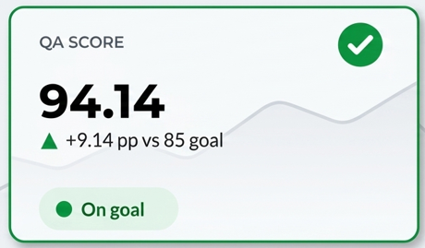
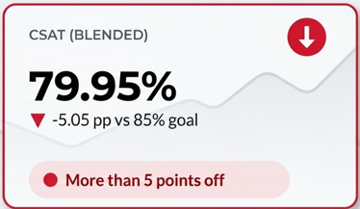
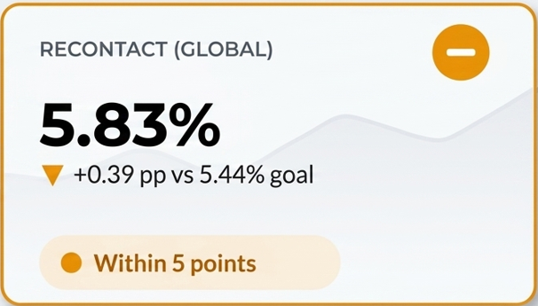
DiDi
Executive summary
03 / 35
Monthly operational KPI scorecard and diagnostic summary.
QA SCORE
CSAT (BLENDED)
RECONTACT (GLOBAL)
May in volume
94.14
79.95%
5.83%
994,591
Customer contacts
+9.14 pp vs 85 goal
-5.05 pp vs 85% goal
+0.39 pp vs 5.44% goal
77,266
CSAT surveys
On goal
More than 5 points off
Within 5 points
2,460
QA audits
Key Performance Takeaways & Structural Findings
Status legend
Scorecard Divergence (2 of 3 Missed): High QA compliance (94.14) fails to translate to customer satisfaction (79.95% CSAT vs 85.0% goal). Recontact finished over tolerance at 5.83% (vs. 5.44% limit) despite a week 4 improvement to 5.26%. QA-CSAT Metric Decoupling (R² = 0.023): Across 45 shared contact reasons, internal QA compliance shows virtually zero correlation with CSAT. Live Chat scores 96.01 QA / 77.6% CSAT, while Phone scores 83.04 QA / 86.3% CSAT. Auditor close rate (not FCR): Phone 9 of 10 assessed (87.9%), Chat 6 of 10 (63.0%). 499 of 658 unresolved chats followed process. Structural Audit Blind Spots: Resolution Masking: 527 audits followed SOPs without resolving the case, yet averaged 96.87 QA. Rubric Distortion: Chat lacks critical penalties for inaccurate information, allowing 80% of process-failing chats (297/372) to score 100. Correcting this rubric drops true Chat QA to 80.14.
Green : at or above goal.
Amber : within 5 points of goal.
Red : more than 5 points off goal.
QA is measured against 85. CSAT against 85%. Recontact against 5.44%, and lower is better. That 5.44% goal is on the global rate (all channels). Built on 2,460 audits, 77,266 surveys and 994,591 contacts.
DiDi Global, CX Service Operations | Confidential. Internal use only

Slide 4
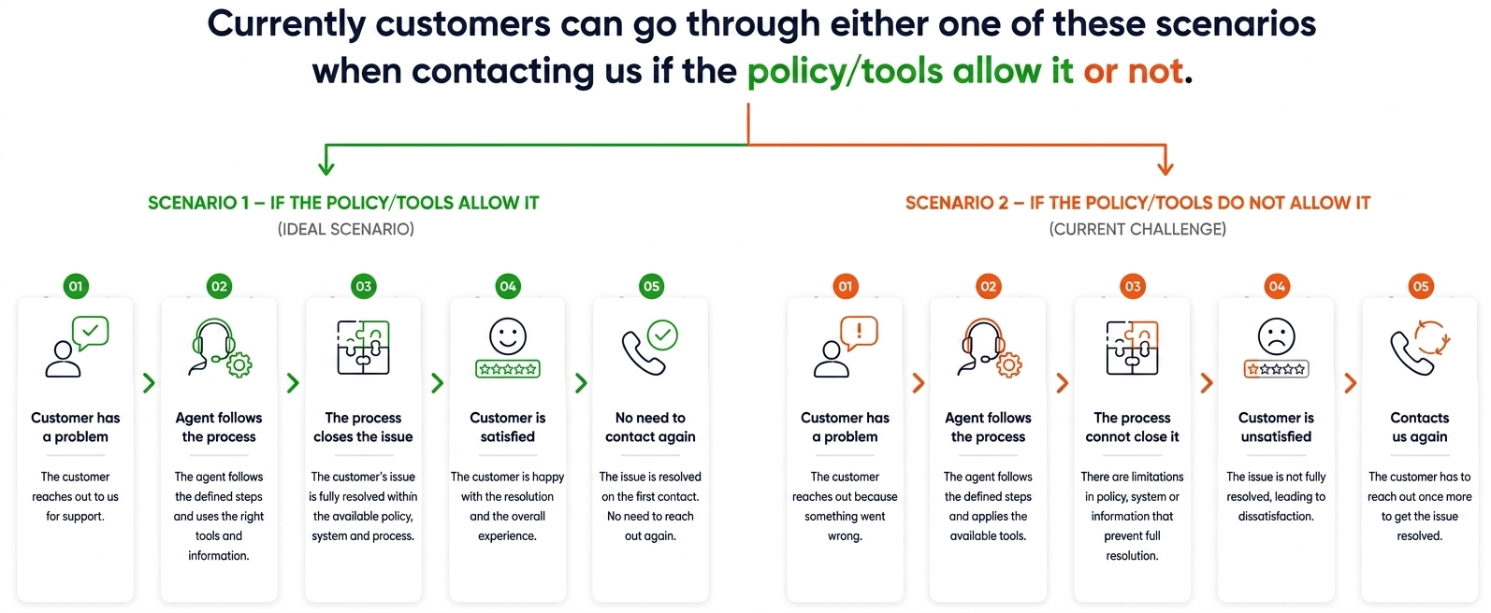
DiDi
Two paths after the same QA step
04 / 35
QA scores step 2. CSAT scores step 4. Recontact is step 5. Close vs CSAT R² 0.64 · QA vs CSAT R² 0.023
If policy / tools allow it
If they do not
Step 2 · QA
1,169 audits resolved + followed process · QA 95.86
527 audits not resolved + followed process · QA 96.87
Step 3 · Close
Closed 1,415 of 2,114 assessed (66.9%)
75.4% of not-resolved still followed process · 215 policy + 116 tools
Step 4 · CSAT
Wrong / damaged / inedible / incomplete order: 89–92% CSAT
Order status & delays: 64.7% CSAT despite QA 97.3
Step 5 · Recontact
Those reasons: 2.9–5.2% recontact
Order status & delays: 19.34% (7,680 repeats) · Human channels 15.56%

Slide 5
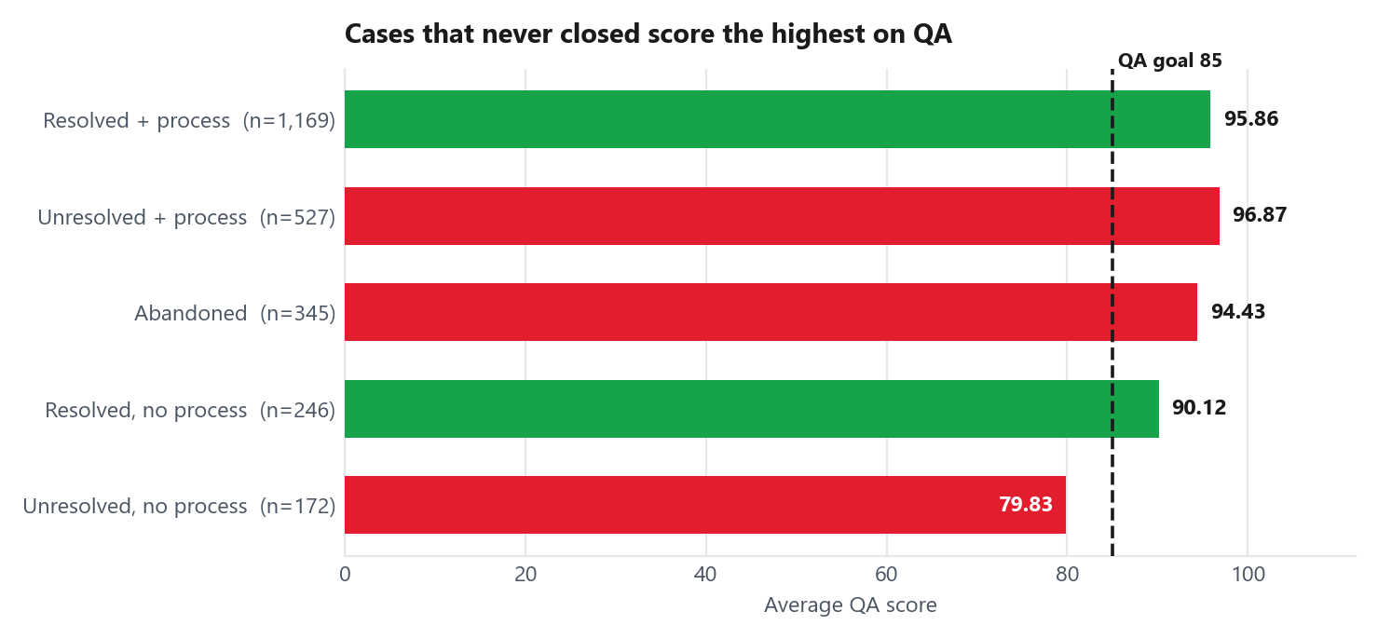
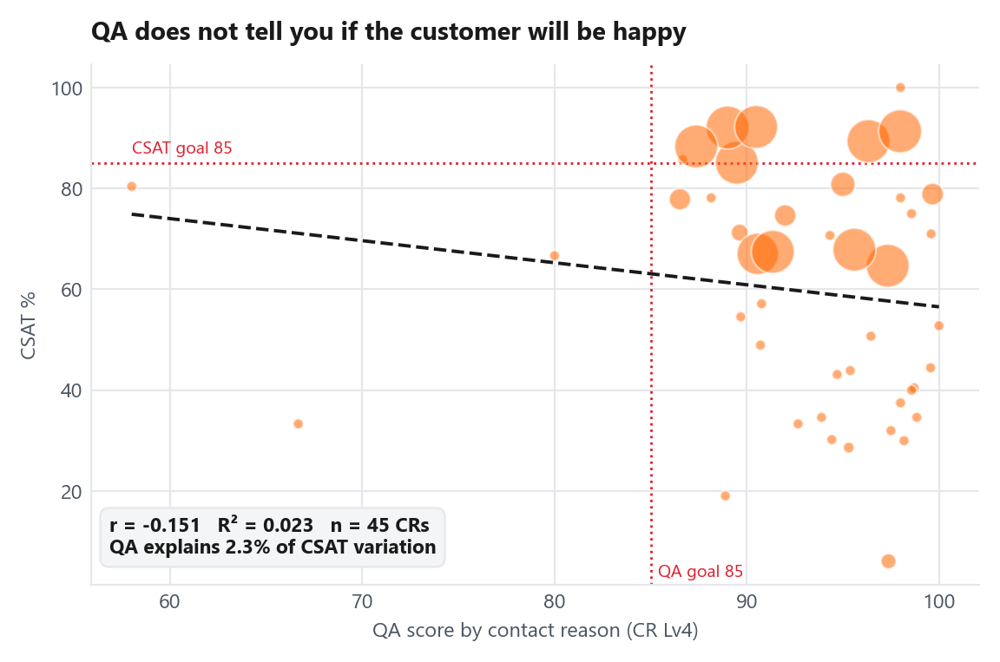
DiDi
Structural QA Flaws: Process Compliance vs. Case Resolution
05 / 35
Internal QA audits conversational compliance; customers rate outcome resolution.
Audit Breakdown & Rubric Flaws
Does higher QA mean better customer outcomes?
Resolution Masking: 527 audits followed SOPs without resolving the issue, yet averaged a 96.87 QA score (higher than resolved cases at 95.86).
Inverse Correlation ($r = -0.151$): Across 45 shared contact reasons, QA scores show a slight negative relationship with customer satisfaction.
Unpenalized Process Fails: Due to lenient rubrics, 80% of chats with process failures (297 of 372) received a perfect score of 100.
Negligible Predictive Value (R2 = 0.023): QA compliance accounts for only 2.3% of CSAT variance, proving internal QA has virtually no bearing on customer sentiment.
Score Recalibration Impact: Aligning Chat evaluation criteria with Phone standards lowers true Chat QA from 96.01 to 80.14 (below the 85.0 target).
Resolution vs. Compliance: CSAT tracks closure, not process. Phone closes 9 of 10 assessed (87.9%); Chat 6 of 10 (63.0%). 499 of 658 unresolved chats followed process. The rubric fix makes QA honest; CSAT moves when policy and tools let agents close.
DiDi Global, CX Service Operations | Confidential. Internal use only

Slide 6
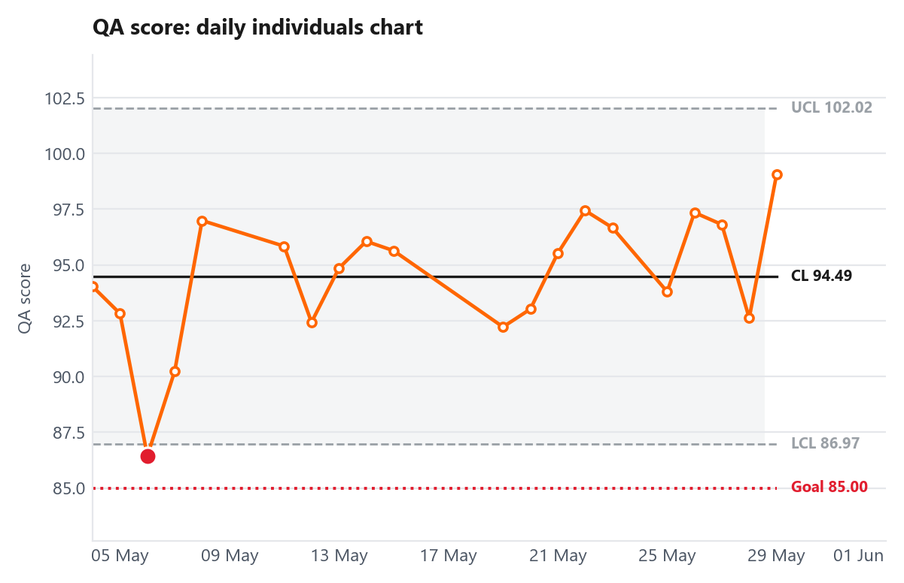
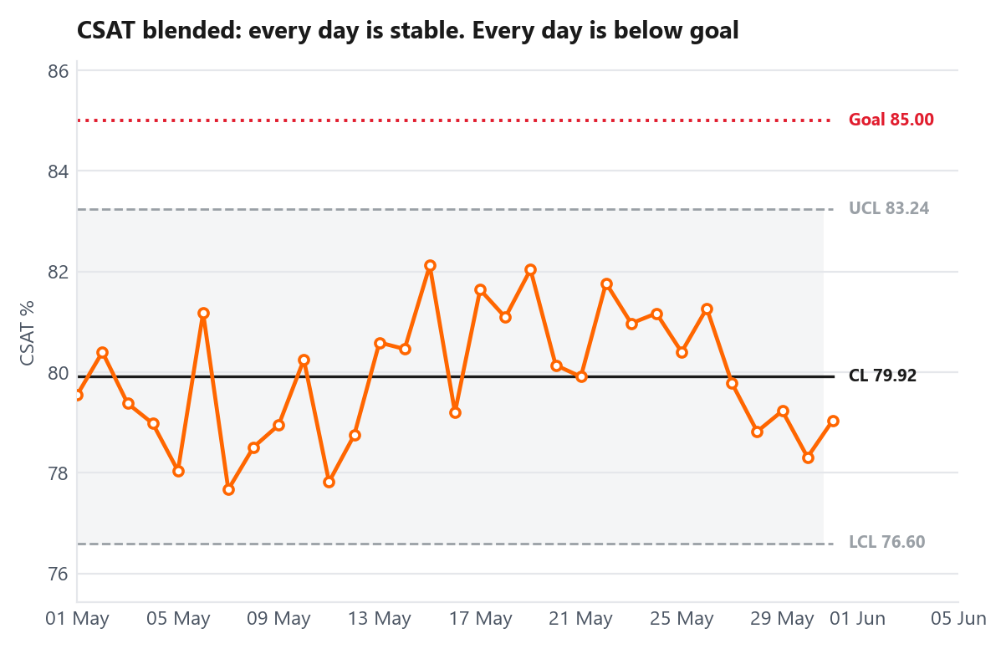
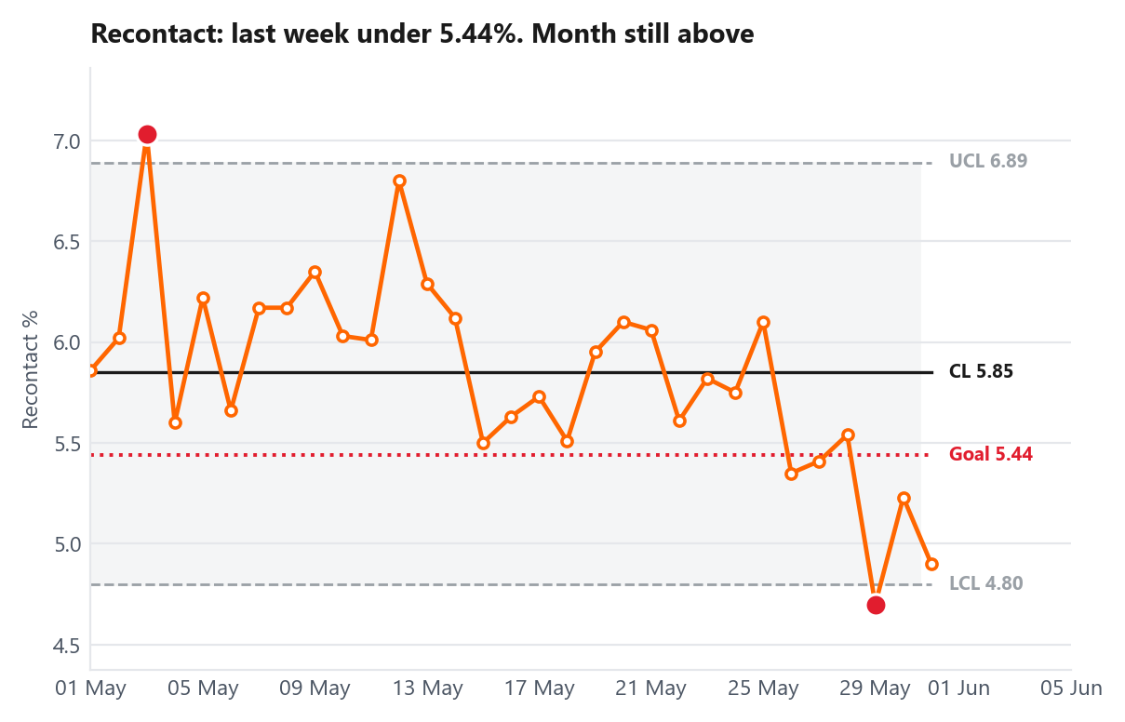
DiDi
Monthly Trend Review
06 / 35
Daily Control Chart Analysis: Monthly stability vs. target performance.
QA: one dip on 6 May. Otherwise steady
CSAT blended: steady. Every day below goal
Recontact global: last week under goal. Month still amber
Blended CSAT remained below target throughout the month
Structural Process Deficit: All 31 days operated strictly within normal statistical control limits (LCL 76.60% – UCL 83.24%), yet 100% of daily data points failed to meet the 85.0% CSAT target. This confirms common-cause process limitation rather than isolated operational noise.
Metric Trajectory: QA maintained steady performance near 94.49% (aside from May 6 at 86.44%). Recontact trended favorably in week 4 (5.26%), but finished the month above threshold at 5.83%.
Actionability over Coaching: Because underperformance is embedded in system/policy design, agent coaching alone will not shift results. Sustainable CSAT recovery requires empowering agents with direct resolution tools (e.g., instant refund authority, real-time ETA tracking, clear escalation paths).
DiDi Global, CX Service Operations | Confidential. Internal use only

Slide 7
07 / 35
01
QA analysis
Score against goal by channel and by contact reason. Then the defects behind each gap.
DiDi

Slide 8
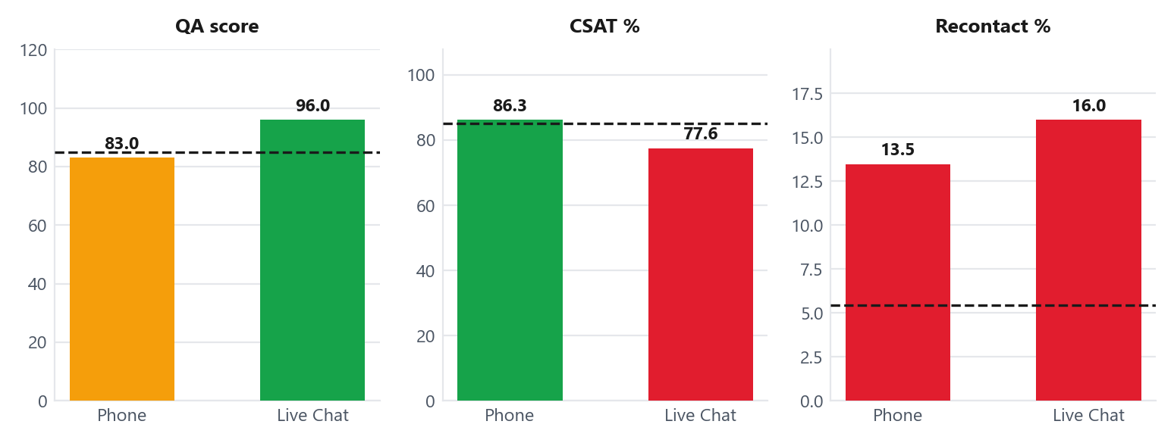
DiDi
QA analysis by channel
08 / 35
Channel-specific performance
Channel
QA
vs 85
Audits
Status
Phone
83.04
-1.96
355
Near goal
Live Chat
96.01
+11.01
2,105
On goal
Key Phone Performance Factors
Higher Case Complexity: Phone tends to absorbs high-friction scenarios, including refund requests, billing disputes, and undelivered orders.
Higher Critical Defect Rate: Phone exhibits a 13.52% critical failure rate—more than 4.5x higher than Live Chat (2.95%).
Sample Weighting Bias: Phone accounts for only 14.4% of total audits (355 evaluations), muting its impact on the blended operational QA score.
QA-CSAT Relation: High Chat Volume & Lenient Rubrics Mask Operational Risks
Phone QA sits below target at 83.04 (-1.96 pts), while Chat reaches 96.01. Chat is 85.6% of audits, so it inflates blended QA to 94.14. Chat's score reflects a lenient form (no critical for information accuracy). Recalibrating Chat to Phone rules drops it to 80.14. Among assessed contacts (not FCR), Phone still closes 9 of 10 (87.9%) and Chat 6 of 10 (63.0%). Phone CSAT 86.3% vs Chat 77.6%. The greener QA score is the weaker closer.
DiDi Global, CX Service Operations | Confidential. Internal use only

Slide 9
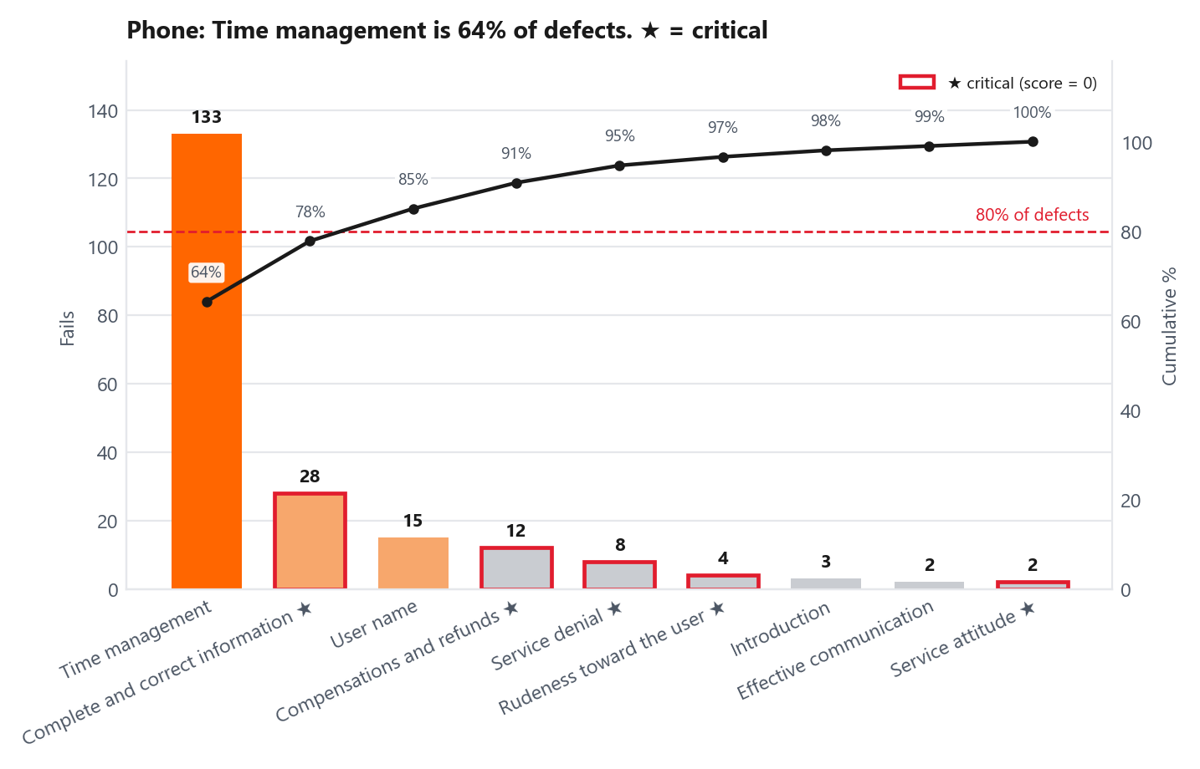
DiDi
QA analysis: Phone
09 / 35
355 audits · 12 attributes · score 83.04 vs 85 goal
Contact reasons with the lowest QA
Contact reason (CR Lv4)
QA
n
Status
Completed but not received — market place
47.5
4
Off goal
Active order, already received
65.8
12
Off goal
Paying the courier
66.7
3
Off goal
Completed but not received — full service
68.2
49
Off goal
Courier overcharged me
68.6
7
Off goal
Root Causes Behind Low QA Drivers
High-Friction Use Cases: Low-scoring contacts concentrate in complex financial and delivery disputes (e.g., undelivered orders, courier fees) that require external tool verification.
Defect Breakdown
Primary Volume Driver: Time Management is 64.3% of Phone fails (133). This month: system-check script at the start of money and undelivered calls; escalate if no data in 2 minutes.
System-Induced Delays: Dependency on backend tools prolongs call duration, directly inflating Time Management defect rates.
Disproportionate Score Drag: Complete & Correct Information is 28 fails and -6.55 pp (critical). This month: 1-page job aid for undelivered/refund CRs; coach the agents on those 28 audits.
Critical Failure Severity: Inaccurate guidance or incomplete policy execution during complex disputes triggers automatic zero-score audits.
Concentrated Root Causes: Together 77.8% of Phone defects. Month 1 Phone work is these two attributes only.
Resolution Bottleneck: Phone still closes 9 of 10 assessed contacts (87.9%; abandon 4.8%). The 1 that does not close is mostly undelivered or refund; 28 of 41 unresolved followed process.
DiDi Global, CX Service Operations | Confidential. Internal use only

Slide 10
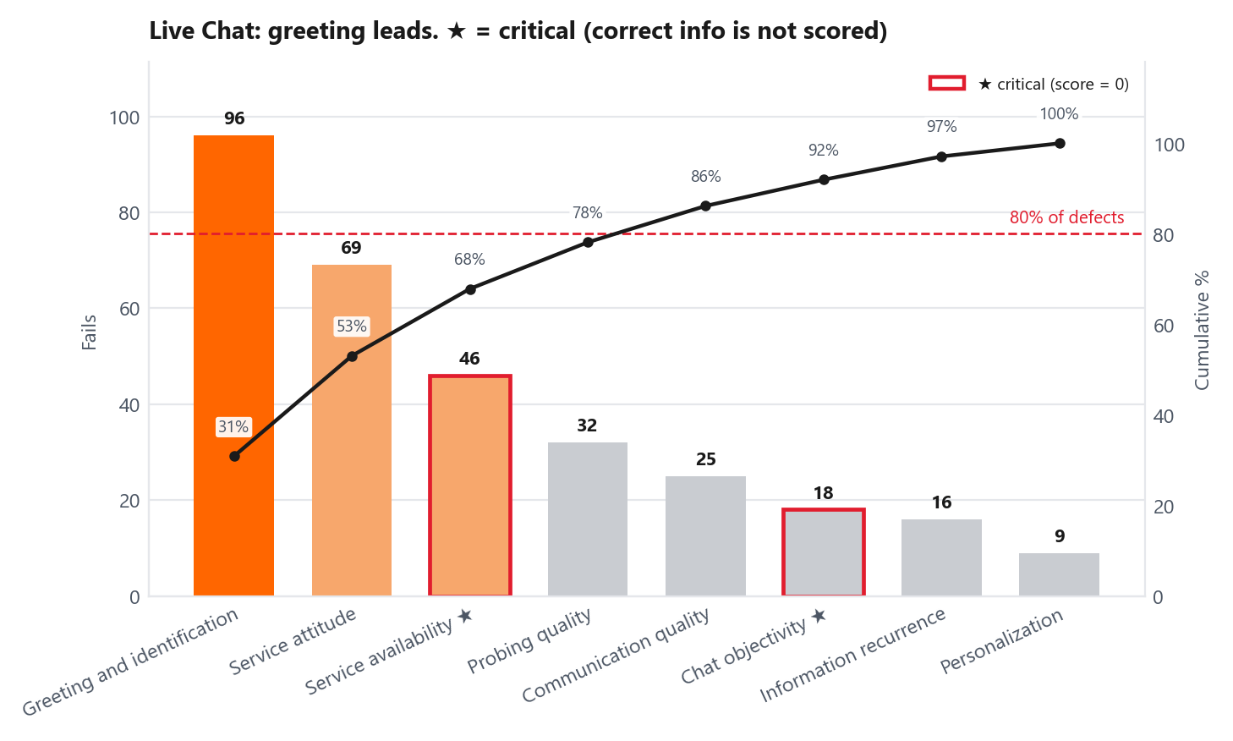
DiDi
QA analysis: Live Chat
10 / 35
2,105 audits · 8 attributes · official score 96.01 vs 85 goal
Contact reasons with the lowest QA
Contact reason (CR Lv4)
QA
n
Status
verbal aggression
76.0
5
Off goal
referral coupon information
80.0
5
Near goal
store registration
80.0
5
Near goal
cancel the order
86.7
9
On goal
modify payment method
86.7
9
On goal
Root Cause & Score Distortion o Structural Rubric Gap
Defect Breakdown
Channel Disparity: Unlike Phone evaluations, Live Chat does not categorize Information Accuracy & Completeness as a critical failure.
Soft Skill Bias: Greeting (30.9%) and Service Attitude (22.2%) are 53.1% of Chat defects. This month: mandatory open-chat greeting/ID macro, and next-step macros on stuck CRs.
Artificial Score Inflation: 80% of chats with process failures (297 out of 372) currently receive a perfect score of 100.
Highest Score Drag: Service Availability is 46 fails and -2.10 pp (critical). This month: WFM/Chat Ops on queue, wrap-up, and not leaving the chat hanging.
Recalibrated Score Impact: Chat closes 6 of 10 assessed (63.0%; abandon 15.6%). 499 of 658 unresolved chats followed process. Recalibrating the form drops QA to 80.14; it does not close those cases.
Rubric Blind Spot: The form still does not score information accuracy. That is a measurement change, separate from this month's defect correction.
DiDi Global, CX Service Operations | Confidential. Internal use only

Slide 11
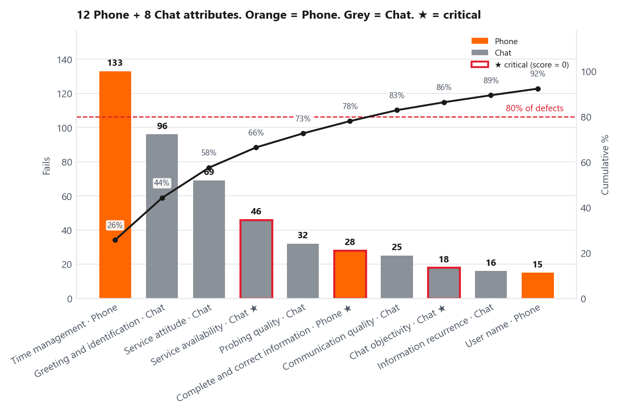
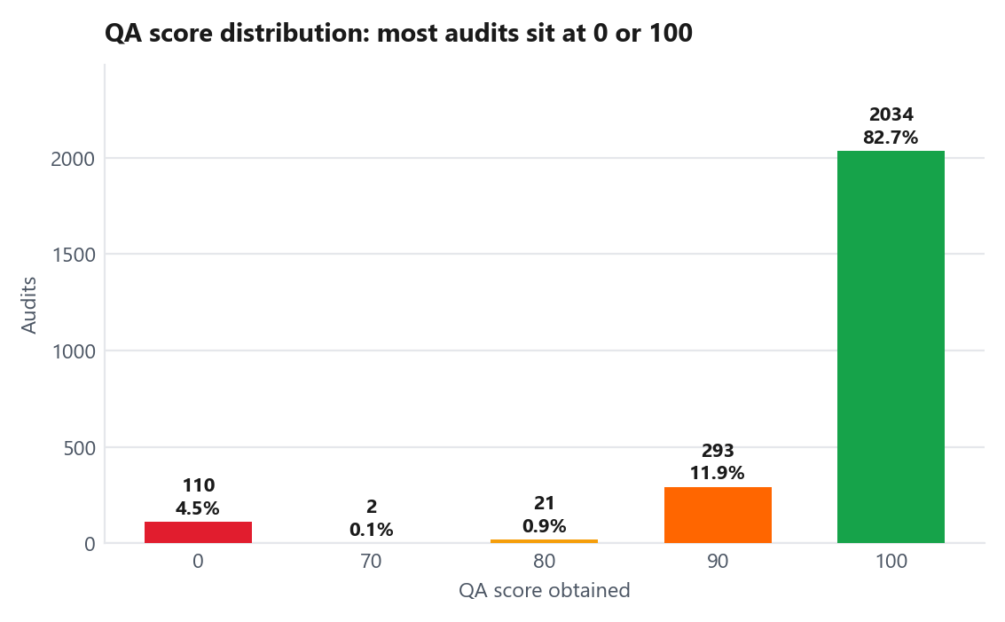
DiDi
QA analysis: where the defects are
11 / 35
"Consolidated cross-channel view evaluating 20 QA attributes (12 Phone, 8 Chat)."
Score Distribution & Scale Behavior
Defect Concentration Analysis
Polarized Results: 82.7% of evaluated contacts achieve a perfect score (100), while 4.5% score a complete zero due to critical failures.
Defect Concentration (80/20): Just 7 attributes account for 82.8% of total audit failures (518 fails across both channels).
Critical Failures (★): Critical attributes carry maximum risk as single failure triggers an automatic zero score for the entire audit.
Binary Scale Behavior: Only 12.8% of audits fall in the mid-range (70–90 pts), causing the QA evaluation to behave more as a binary pass/fail indicator than a continuous diagnostic metric.
Volume vs. Severity Trade-off: Time Management is the highest Phone volume fail; Complete & Correct Information is the highest Phone score drag. Month 1: those two plus Chat greeting, attitude, and availability.
DiDi Global, CX Service Operations | Confidential. Internal use only

Slide 12
DiDi
QA analysis: where we concentrate this month
12 / 35
Correct the defects we already score. Chat information accuracy is a scoring change, separate from this list.
Defect
Channel
How we correct it
Who
When
Time management (133 fails, 64.3%)
Phone
System-check script at the start of money and undelivered calls. Escalate if no data in 2 minutes.
Supervisors
27 Jun
Complete and correct information (28 fails, -6.55 pp)
Phone
1-page job aid for undelivered and refund CRs. Coach the agents on those 28 audits.
QA Lead + Supervisors
27 Jun
Greeting and identification (96 fails, 30.9%)
Live Chat
Mandatory open-chat greeting and identification macro.
Chat Ops + QA Lead
13 Jun
Service attitude (69 fails, 22.2%)
Live Chat
Next-step macros on stuck CRs. Recalibrate attitude when the case cannot close.
Chat Ops + QA Lead
27 Jun
Service availability (46 fails, -2.10 pp)
Live Chat
WFM and Chat Ops on queue, wrap-up, and chats left hanging. This is the Chat critical we already score.
WFM + Chat Ops
13 Jun
This is defect correction, not a scoring change
These five attributes are already on the form. Adding Chat correct-information as a critical is a separate scorecard change (Chat QA would read 80.14). It does not lift CSAT. Cases that followed process and still did not close belong to process, not to the agent.
DiDi Global, CX Service Operations | Confidential. Internal use only

Slide 13
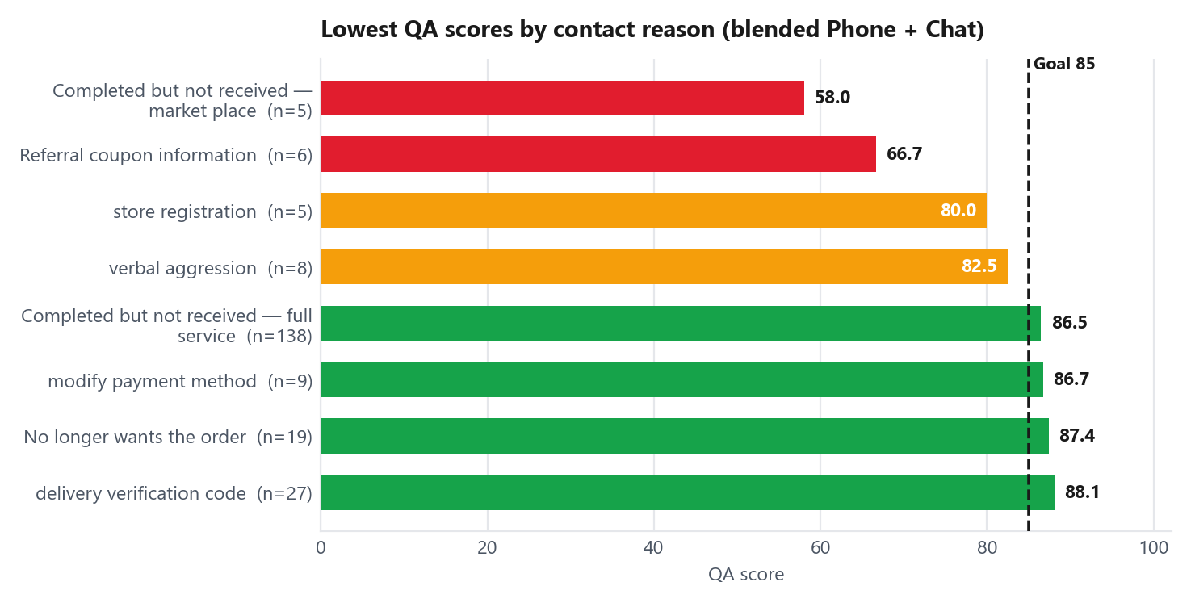
DiDi
Contact Reason QA Breakdown (CR Lv4)
13 / 35
Blended ranking (Phone + Chat together). Official QA never mixes the two lists. At least 3 audits.
Lowest QA reasons (blended)
Contact reason
QA
n
Status
Completed but not received — market p…
58.0
5
Off goal
Referral coupon information
66.7
6
Off goal
store registration
80.0
5
Near goal
verbal aggression
82.5
8
Near goal
Completed but not received — full ser…
86.5
138
On goal
Drivers of Channel Metric Divergence
Blended vs. Isolated Governance: Blended views create false positives; operational decisions require channel-isolated audits.
Aggregation Risk: High Chat Volume Masks Critical Voice Failures
Channel Performance Variance: "Verbal aggression" averages 82.5, but isolating channels reveals a critical deficit in Chat (76.0, N=5) versus Phone (93.3, N=3).
Channel Masking Effect: Blending channels conceals critical voice underperformance. For example, "Completed but not received — full service" scores a failing 68.2 QA on Phone (N=49). When blended with high-volume Chat, the score artificially rises to 86.5 QA (N=138) diluting severity without fixing the root cause in Phone.
Volume-Driven Masking: "Undelivered full-service" appears compliant at 86.5 (N=138), hiding a failing 68.2 Phone baseline (N=49). That CR is also the fail-volume leader (37 attribute fails). Lowest blended score is marketplace on 4 audits. Next slide splits rate vs volume.
Operational Risk: Relying solely on blended averages allows critically failing voice queues ("red") to masquerade as compliant ("green").
DiDi Global, CX Service Operations | Confidential. Internal use only

Slide 14
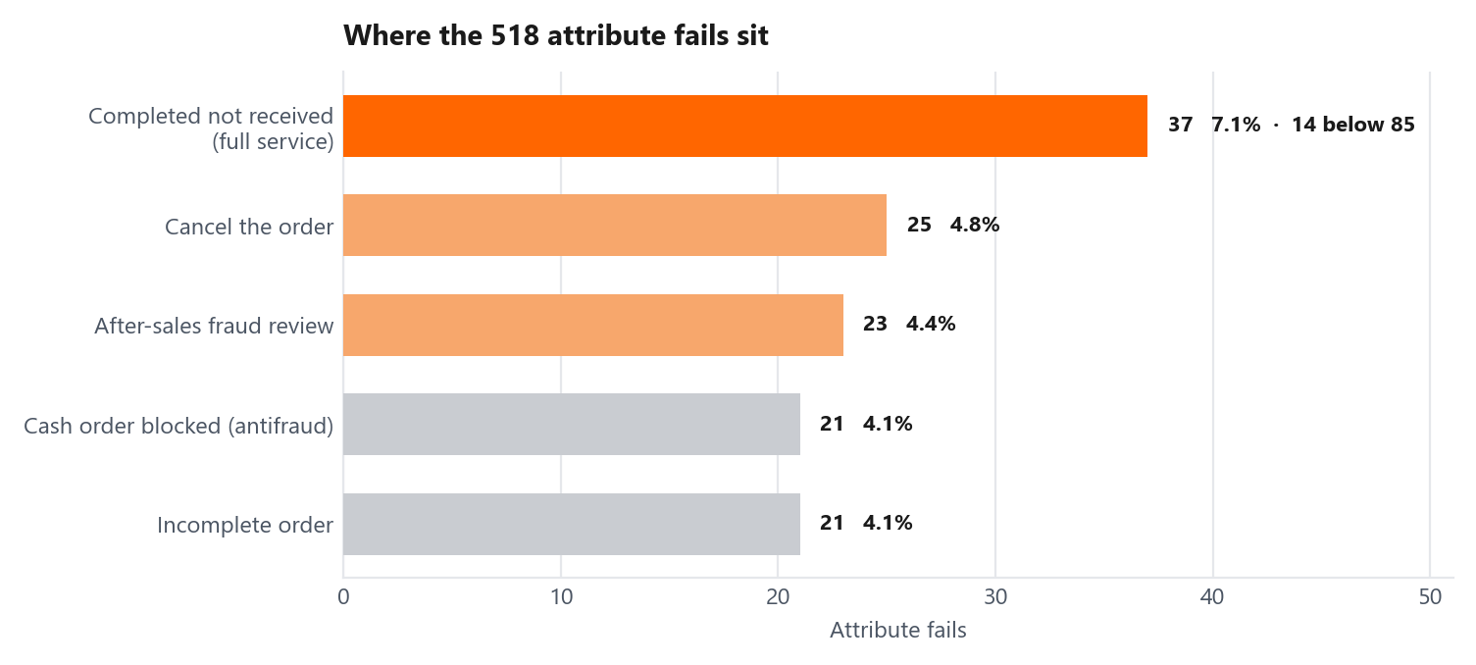
DiDi
QA analysis: lowest score vs fail volume
14 / 35
A red score on 4 audits is not the same as 37 fails on one contact reason.
Lowest QA (rate, n >= 3)
Contact reason
QA
n
Start here?
Completed not received (market place)
47.5
4
Too few
Active order, already received
65.8
12
Watch
Completed not received (full service)
68.2
49
Start
Verbal aggression
76.0
5
Too few
Refund status and conditions
76.4
25
Start
Phone QA volume focus is one contact reason. Chat QA fails are spread.
Completed-not-received full service is 26% of Phone audits below 85 (14 of 53) and the single largest attribute-fail pile (37 of 518). Marketplace at 47.5 QA is 4 audits. Do not start coaching there. Chat below-goal audits (80) have no CR above 8% of that pile. Chat QA work stays on attributes (greeting, attitude, availability), not on one CR.
DiDi Global, CX Service Operations | Confidential. Internal use only

Slide 15
15 / 35
02
CSAT and voice of the customer
Blended CSAT against goal. Then Phone vs Chat. Who is dragging it. What detractors say.
DiDi

Slide 16
DiDi
CSAT analysis
16 / 35
Blended 79.95% vs 85% · Phone 86.26% · Chat 77.55% · 77,266 surveys
Channel
CSAT
Surveys
vs 85
Status
Phone vs Chat vs blended
Phone
86.3%
21,304
+1.26 pp
On goal
Channel Volume Drag: Live Chat dominates customer sentiment with 72.4% of total surveys (55,962). Its failing score of 77.6% (-7.45 pp vs. goal) completely drags down Phone's passing performance of 86.3% (+1.26 pp vs. goal) to a blended 80.0%.
Live Chat
77.6%
55,962
-7.45 pp
Off goal
Blended (official)
79.95%
77,266
-5.05 pp
Off goal
Contact reason (CR Lv4)
Blended
Phone
Chat
Surveys
Contact reasons dragging CSAT down (blended)
Order status / delay inform…
67.8%
80.3%
62.8%
9,918
Systemic Chat Vulnerability in High-Friction Cases: Across all bottom-performing contact reasons, Phone outperforms Live Chat by 12.3 to 21.7 percentage points: Refund Status & Conditions: Chat collapses to 57.0% CSAT vs. Phone's 78.7% (a 21.7 pp gap). Order Status & Delays: Chat drops to 60.3% CSAT vs. Phone's 79.8% (a 19.5 pp gap). Those CRs are also the detractor pile: order-status family plus cancellation charge is 44.8% of unsatisfied surveys. The volume split is two slides later (rate vs the 15,488-unsatisfied pile). Order Status / Delay Info: Chat records 62.8% CSAT vs. Phone's 80.3% (a 17.5 pp gap across 9,918 surveys).
Disagrees with cancellation…
67.4%
77.6%
63.6%
5,992
order status & delays
64.7%
79.8%
60.3%
5,096
No longer wants the order
88.3%
94.2%
81.9%
10,518
refund status and conditions
67.0%
78.7%
57.0%
3,582
DiDi Global, CX Service Operations | Confidential. Internal use only

Slide 17
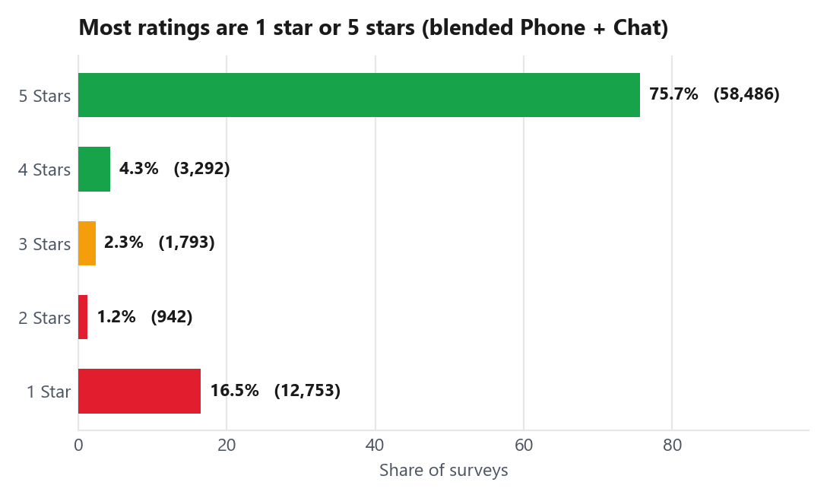
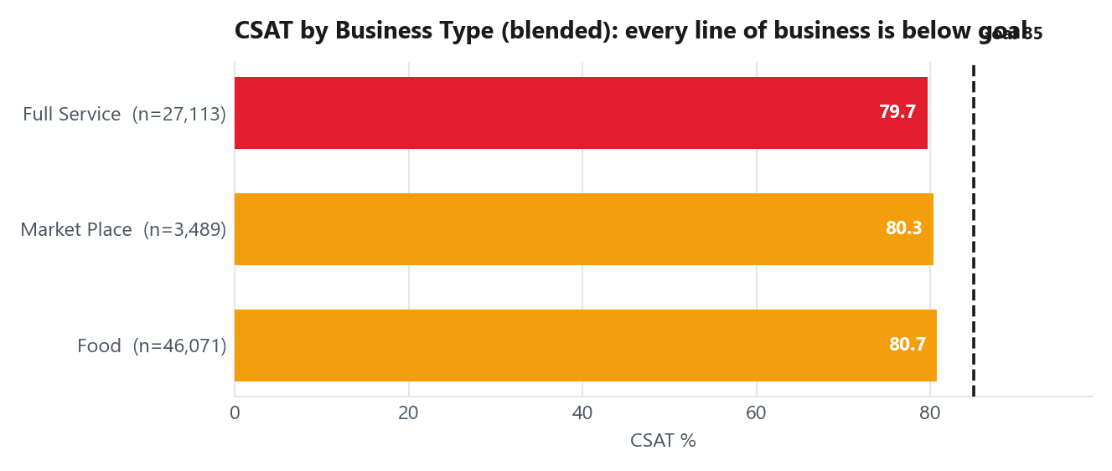
DiDi
CSAT analysis
17 / 35
Blended 79.95% vs 85% · Phone 86.26% · Chat 77.55% · 77,266 surveys
Customer Sentiment
Line of Business
Bimodal Rating Polarization: Customer perception follows an "all-or-nothing" distribution: 92.2% of ratings are binary extremes (75.7% 5-star vs. 16.5% 1-star). Neutral/mid-tier ratings (2–4 stars) represent only 7.8%, proving customers evaluate contacts as total success or complete failure.
Uniform LOB Deficit: Underperformance is consistent across all business lines (79.7%–80.7%), with Food generating 59.6% of total survey volume (46,071) at 80.7% CSAT.
DiDi Global, CX Service Operations | Confidential. Internal use only

Slide 18
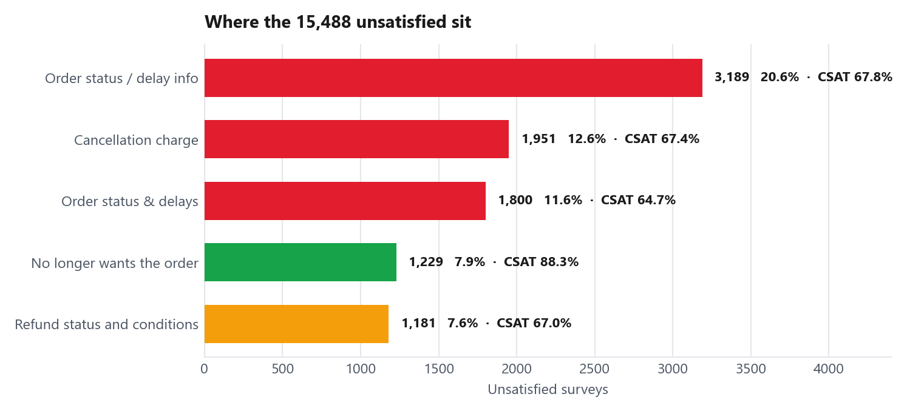
DiDi
CSAT analysis: lowest score vs detractor volume
18 / 35
15,488 unsatisfied surveys. Priority is share of that pile, not the ugliest percentage.
Worst CSAT (rate, min 100 surveys)
Contact reason
CSAT
Surveys
Share
After-sales fraud review
6.1%
475
2.9%
Other (unmapped Business Type)
26.5%
558
2.6%
Membership program renewal
28.6%
248
1.1%
Membership program benefits
43.1%
109
0.4%
Placing an order information
50.7%
142
0.5%
CSAT focus is order status, cancellation charge and refunds. Not fraud.
The two order-status reasons plus cancellation charge are 44.8% of every unsatisfied survey. Add refunds and the top five are 60.3%. After-sales fraud is 6.1% CSAT and only 2.9% of the pile. No longer wants the order is 88.3% (above goal) and still 7.9% of detractors: volume without a rate problem. Do not staff that CR. ETA and refund path are the volume unlock.
DiDi Global, CX Service Operations | Confidential. Internal use only

Slide 19
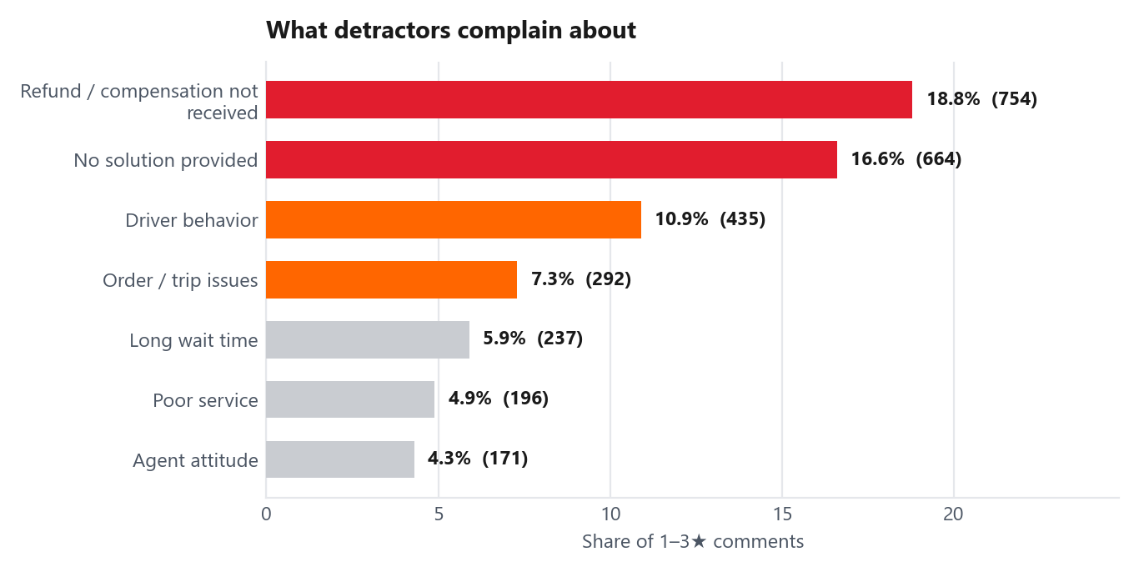
DiDi
Voice of the customer
19 / 35
2,749 classified comments from 1–3★ surveys
Detractor Driver Disconnect: Resolution vs. Soft Skills
Resolution Deficit Dominates (35.4%): Missing refunds (18.8%) and lack of solution (16.6%) drive over a third of all negative verbatim feedback.
Soft Skills Over-Weighting (4.3%): "Agent attitude" accounts for only 4.3% of detractor complaints (171 comments), despite being heavily weighted in traditional QA rubrics.
Operational Takeaway: Customers evaluate experience based on functional problem-solving, not conversational politeness.
Dissatisfaction Ownership Breakdown
Owner the auditor tagged
Cases
Share
CX Process
54
49.5%
Does higher QA mean better customer outcomes?
CSAT Correlation (r = -0.151, R2 = 0.023): QA scores explain only 2.3% of CSAT variance across 45 contact reasons.
Recontact Correlation (r = -0.078): QA compliance shows a slightly negative correlation with recontact reduction.
Strategic Conclusion: Optimizing for current QA metrics will not shift CSAT or lower repeat contacts, as standard audits measure compliance rather than the process resolution required by customers.
People (CSR)
24
22.0%
End User
11
10.1%
External Factors
10
9.2%
DiDi Global, CX Service Operations | Confidential. Internal use only

Slide 20
20 / 35
03
Recontact analysis
Rate against goal. Which channels and contact reasons drive repeat contacts.
DiDi

Slide 21
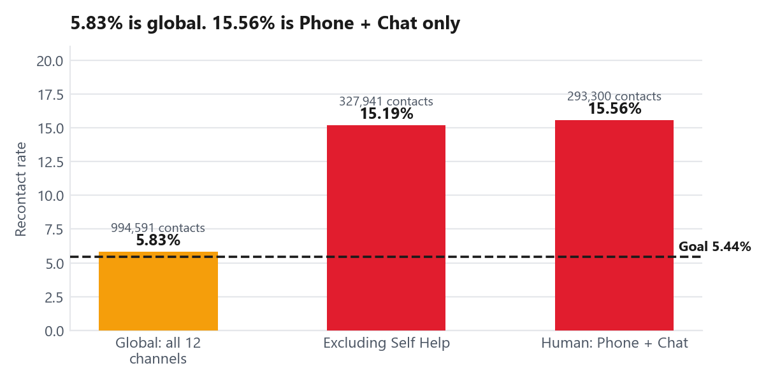
DiDi
Recontact analysis
21 / 35
5.83% is global (all 12 channels) vs 5.44% goal · Human channels (Phone + Chat): 15.56%
Rate by channel: where customers contact us again
Channel
Contacts
Repeats
Rate
Share of repeats
Live Chat
243,626
38,961
15.99%
67.2%
Self Help
666,650
8,154
1.22%
14.1%
Phone
49,674
6,690
13.47%
11.5%
GPTBot
19,508
2,679
13.73%
4.6%
Help Center
12,224
941
7.70%
1.6%
Automation Masking Effect: Self-Help Disguises Human Channel Deficit
Metric Masking: Massive Self-Help volume (666.6k contacts / 67.0% share) maintains a low 1.22% recontact rate, artificially keeping global business reporting at 5.83% (near the 5.44% target).
Assisted Channel Deficit: Removing Self-Help exposes an assisted recontact rate of 15.19%, peaking at 15.56% for human channels (Phone + Live Chat)—nearly 3x the maximum operational tolerance (5.44%).
Volume Driver: Live Chat single-handedly generates 67.2% of all repeat contacts in the business (38,961 repeat cases).
Dual-Metric Governance: Reporting vs. Operational Performance
Volume Skewing: Self-Service absorbs 67.0% of total volume with a 1.22% recontact rate, masking operational friction in human channels.
1-in-6 Recontact Ratio: Human-assisted channels operate at 15.56% recontact, meaning 1 out of every 6 customers contacting an agent requires a repeat interaction.
Digital Channel Friction: Live Chat (15.99%) and GPTBot (13.73%) exhibit higher recontact rates than Phone (13.47%), proving digital channels are the main source of repeat contact.
DiDi Global, CX Service Operations | Confidential. Internal use only

Slide 22
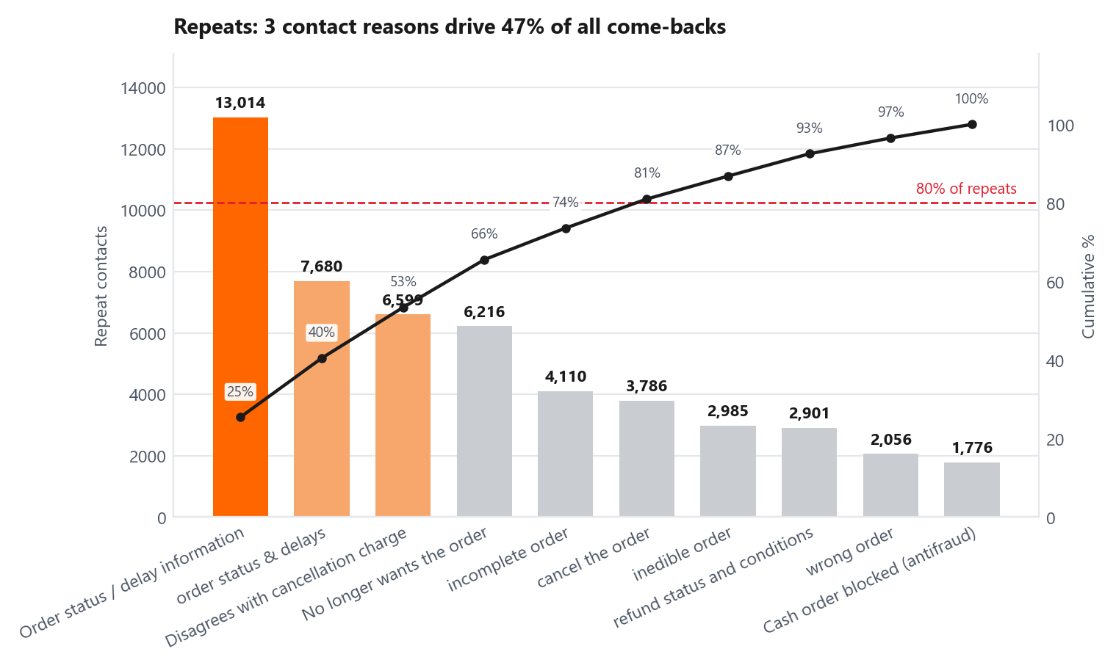
DiDi
Recontact by contact reason
22 / 35
Granular recontact driver analysis: Pareto concentration, friction rate isolation, and QA/CSAT metric decoupling.
Highest recontact rates
Contact reason
Contacts
Repeats
Rate
Status
After-sales fraud review
3,146
895
28.45%
Off goal
Cash order blocked (ant…
7,278
1,776
24.40%
Off goal
order status & delays
39,706
7,680
19.34%
Off goal
Order status / delay in…
76,911
13,014
16.92%
Off goal
refund status and condi…
18,484
2,901
15.69%
Off goal
Rate = repeats ÷ contacts of that reason. More repeats ≠ higher rate.
How this compares with QA and CSAT
Phantom Compliance (93%–98% QA): High-recontact reasons consistently achieve near-perfect QA scores (93%–98%), proving that QA rubrics reward procedural compliance while ignoring customer resolution gaps.
Where the volume sits
Single Point Volumetric Driver: "Order status / delay information" generates 13,014 repeat cases alone (22.4% of total repeats) across 76,911 interactions.
CSAT Collapse Alignment: High recontact directly mirrors severe CSAT failure—notably in "Order Status" (64.7% CSAT) and "Refund Status" (67.0% CSAT).
Top 3 Concentration (47.0%): Combined with "Order status & delays" (7,680) and "Disagrees with cancellation charge" (6,595), just 3 reasons account for 27,289 repeat contacts.
80/20 Rule Validation: Expanding the scope to 6 contact reasons accounts for 81.0% of total recontact volume, defining the exact operational scope needed to restore FCR (First Contact Resolution).
Strategic Diagnostic: High QA scores mask unresolved customer friction. When an agent follows process without delivering immediate resolution or clear timelines, customer dissatisfaction and repeat contact remain inevitable.
DiDi Global, CX Service Operations | Confidential. Internal use only

Slide 23
23 / 35
04
People: where coaching should focus
Which agents sit outside the pack. Which teams carry the coaching load.
DiDi

Slide 24
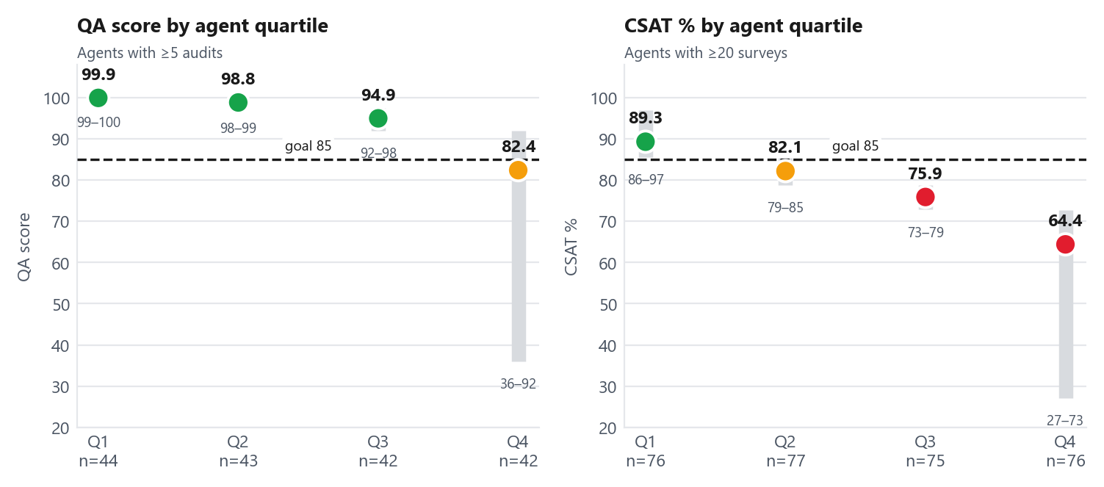
DiDi
Who needs attention: agent quartiles
24 / 35
Comparative variance analysis: Metric score-ceiling saturation vs. operational performance dispersion (171 QA-audited / 304 CSAT-evaluated agents).
High-Liability Outliers: Priority Coaching Matrix
Agent
QA
Audits
Team
Coaching priority
Agent 228
36.0
5
S13
245
Agent 21
61.7
6
S9
140
Agent 135
66.7
6
S12
110
Agent 44
71.4
7
S7
95
Agent 171
80.0
17
S20
85
Coaching Priority Formula: (Target 85 – QA Scor) x Audits. Prioritizes high-volume operational liability
Metric Ceiling Compression: QA Homogeneity vs. CSAT Dispersion
Targeted Coaching Allocation
High-Concentration QA Liability: 26 agents fail the 85.0 QA goal. Concentrating coaching on the top 5 outliers resolves 55% of total floor coaching liability (led by Agent 228 with a priority score of 245).
Cohort Disconnect (QA vs. CSAT): QA Q4 (42 agents, 82.4 avg) and CSAT Q4 (76 agents, 64.4% avg) comprise mostly different individuals, proving compliance coaching will not automatically solve customer dissatisfaction.
Tenure Degradation Risk (>1 Year Tenure): Agents with >1 year tenure represent the worst-performing cohort across both metrics—registering the only group below QA target (83.97) and the lowest CSAT average (74.1%), signaling procedural drift or burnout.
Score Ceiling Saturation (88% Ceiling): 75% of the agent floor (Q1–Q3) scores between 94.9 and 99.9 on QA, driven by rubric leniency where 88% of Chat audits hit the maximum score (100).
Severe CSAT Dispersion (27.1% – 96.9%): While QA appears uniformly compliant, CSAT exposes massive execution gaps. Only Q1 (89.3%) meets the 85.0% CSAT goal; Q2, Q3, and Q4 all fail the target (64.4%–82.1%).
Diagnostic Invalidation: QA fails as a performance discriminator. Ranking agents by QA masks real underperformance that CSAT clearly isolates.
DiDi Global, CX Service Operations | Confidential. Internal use only
DiDi Global, CX Service Operations | Confidential. Internal use only · Coaching priority = (85 − QA) × audits, summed. Higher = coach this team/agent first. It weights a real sample, not a one-off.

Slide 25
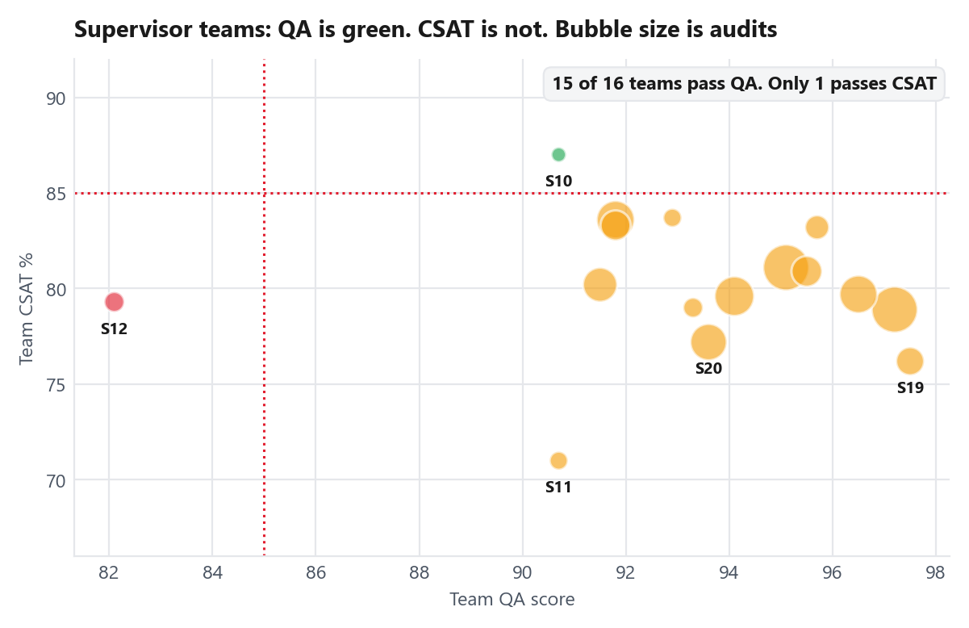
DiDi
Who needs attention: supervisor view
25 / 35
Supervisor team matrix (31 supervisors / 20+ audits threshold): Compliance vs. CSAT execution disconnect and localized team risk.
Supervisor Quadrant Analysis & Structural Team Clustering
Team
Below QA 85
Audits
Worst QA
Coaching priority
S13
3
22
36.0
280
S9
3
16
61.7
220
S20
2
28
79.1
150
S7
4
23
71.4
145
S12
2
12
66.7
120
What the team view shows
Asymmetric Pass Rate (15 vs. 1): 15 out of 16 qualified supervisor teams pass the 85.0 QA threshold, yet only 1 team (S10) achieves the 85.0% CSAT target.
High QA / Worst CSAT Friction (Team S11): Supervisor 11 passes QA with a 90.7 score, yet generates the worst CSAT on the floor at 71.0% across 4,243 surveys, proving team-level compliance management does not translate to customer satisfaction.
Concentrated Team Liability: 5 supervisor teams account for 14 of the 26 underperforming agents (53.8%). Supervisor 7 has 43% of its ranked agents in Q4, indicating structural leadership/coaching failures rather than isolated agent error.
Single-Agent Systemic Risk: Critical QA Audit Blindspot (Agent 212)
Outlier Impact (2.7% Floor Dissatisfaction): Agent 212 recorded a 27.1% CSAT across 564 surveys, accumulating 411 detractor customers. This single individual accounts for 2.7% of all dissatisfied customers in the entire monthly operation.
QA Audit Failure: Standard QA sampling failed to flag this agent a single time, proving current QA audit selection mechanisms are completely disconnected from customer sentiment.
DiDi Global, CX Service Operations | Confidential. Internal use only

Slide 26
26 / 35
05
Combined analysis and root cause
Where QA, CSAT and recontact miss on the same contact reason. Then why.
DiDi

Slide 27
DiDi
Combined analysis
27 / 35
Contact reasons that miss on more than one metric (blended Phone + Chat)
Contact reason (CR Lv4)
QA
Audits
CSAT
Recontact
Repeat volume
Surveys
Pattern
Priority
Order status / delay information
95.6
25
67.8%
16.92%
13,014
9,918
Low CSAT + High Recontact
Act this quarter
order status & delays
97.3
45
64.7%
19.34%
7,680
5,096
Low CSAT + High Recontact
Act this quarter
Disagrees with cancellation charge
91.4
59
67.4%
12.96%
6,599
5,992
Low CSAT + High Recontact
Act this quarter
Refund status and conditions
90.6
70
67.0%
15.69%
2,901
3,582
Low CSAT + High Recontact
Act this quarter
Cash order blocked (antifraud)
93.6
58
n/a
24.40%
1,776
n/a
High Recontact
Monitor
After-sales fraud review
97.4
118
6.1%
28.45%
895
475
Low CSAT + High Recontact
Monitor
QA and CSAT columns are blended Phone + Chat. Refund status QA 90.6 is n=70 (Phone 76.4 n=25 + Chat 98.4 n=45): same contact reason, two casings in the source. Official overall QA still keeps the two attribute lists unmixed.
Auditor Ownership Tagging
The same pattern is visible in a single contact reason
Root-Cause Attribution (2.2:1 Ratio): Auditors attribute 49.5% of dissatisfaction directly to CX Process constraints, compared to just 22.0% caused by agent execution error.
Policy-Driven Failures: 42.2% of cases are categorized as "not resolution-based," reflecting rigid policies that prevent agents from resolving customer issues on first contact.
QA Score Ceiling Masking: Process failures are artificially understated at 17.0% because 88% of Chat QA audits hit the score ceiling (100), masking underlying systemic friction.
Metric Disconnect: Generates 97.3 in QA compliance while dropping to 64.7% CSAT and driving a 19.34% recontact rate (7,680 repeat cases in a single month).
Operational Bottleneck: Agents follow guidelines flawlessly, but lack system visibility to view or adjust courier ETAs. The interaction is fully compliant for QA, yet unresolved for the customer.

Slide 28
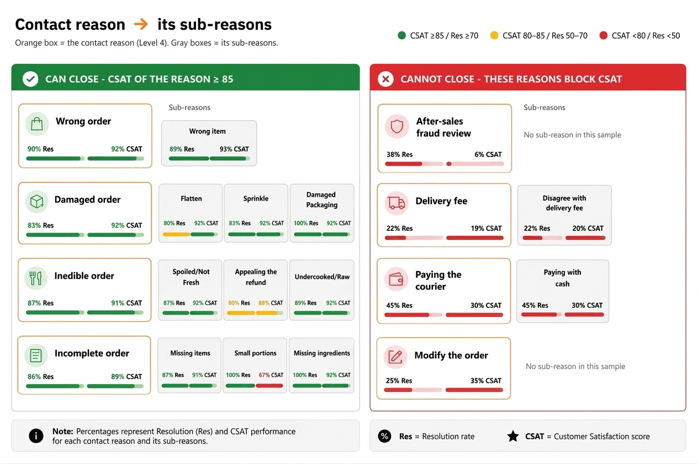
DiDi
Reloution/case closure vs CSAT
28 / 35
correlation analysis across contact reasons
Issue Resolution is the only aspect moving CSAT
Strong Resolution Correlation (r = +0.80, R2 = 0.64): Case closure rate explains 64% of all CSAT variance across 35 contact reasons, proving that a customer's outcome is the single greatest determinant of satisfaction. QA Predictivity Failure (R2 = 0.023): Traditional QA compliance explains less than 2.3% of CSAT variance, demonstrating that agent politeness or script adherence cannot salvage an unfulfilled resolution. Strategic Pivot: Judge channels on close rate, not QA. Phone closes 9 of 10 assessed; Chat 6 of 10. Do not coach Chat volume for a gap that is 499 process-followed non-closes.
Reasons with lower closure rates
Contact reason (Lv4)
Resolved
CSAT
Recontact
Audits
Surveys
After-sales fraud review
38%
6.1%
28.4%
115
475
Delivery fee
22%
19.0%
2.2%
9
21
Paying the courier
45%
30.2%
2.8%
29
96
Modify the order
25%
34.6%
1.7%
12
52
Reasons with higher closure rates
Contact reason (Lv4)
Resolved
CSAT
Recontact
Audits
Surveys
Wrong order
90%
92.2%
2.9%
40
7,359
Damaged order
83%
92.1%
2.9%
47
5,962
Inedible order
87%
91.3%
5.2%
190
7,685
Incomplete order
86%
89.4%
3.2%
171
8,227
After-sales fraud CSAT 6.1% is 29 satisfied / 475 surveys (432 ones). One exception remains: “Refund status and conditions” has a 76% closure rate but only 67.0% CSAT on 3,582 surveys, showing that closure alone does not explain every customer outcome.
DiDi Global, CX Service Operations | Confidential. Internal use only · Audits on this slide = Resolved or Not resolved. After-sales fraud: 115 assessed, 3 Abandoned, 118 in Combined analysis.

Slide 29
DiDi
5 whys: why we could not close, and what closing actually was
29 / 35
Root-cause '5-Whys' auditor diagnostic (2,114 audited cases): Structural policy & tooling barriers in unclosed cases vs. tangible resolution drivers in closed cases.
Structural Non-Closure Bottlenecks (n = 699 Audits)
CSAT of these contact reasons is 52.1%. Not those tickets. Audits and surveys do not share a ticket ID.
Resolution Mechanics (n = 1,415 Audits)
CSAT of these contact reasons is 70.9%. Not those tickets. Audits and surveys do not share a ticket ID.
Why it did not close
Audits
Share
Of those, followed process
What closing was
Audits
Share
Policy blocked refund / close
267
38%
215
Confirmed a refund or compensation
662
47%
No tool — must escalate
158
23%
116
Explained / confirmed the process
124
9%
Other / unclear
103
15%
77
Used a tool or filed a report
156
11%
No analysis (“No aplica”)
88
13%
63
Fraud named in the text
25
4%
19
Other / unclear
251
18%
Courier / store / restaurant
18
3%
12
No analysis (“No aplica”)
145
10%
Model: no low CSAT to analyse
14
2%
8
Cancellation processed
43
3%
Delay / ETA (undercounted)
17
2%
12
Model: no low CSAT to analyse
34
2%
Agent missed the process
9
1%
5
Monetary Remediation Dominance (47%): Direct financial resolution (Refund or compensation) drives 47% of all successful closures (662 cases), identifying financial empowerment as the single most effective resolution tool.
Informational & Tool Enablers (20% Combined): Tool usage/report filing (11% / 156 cases) and Clear process explanations (9% / 124 cases) represent the secondary pillars of successful case closure.
Policy & Tooling Dominance (61% Combined): Policy-blocked refunds/closures (38% / 267 cases) and Missing tooling forcing escalations (23% / 158 cases) account for over 60% of all unclosed interactions.
High Process Compliance (75.4%): In 527 of the 699 unclosed cases, agents strictly adhered to operational protocols. The interaction remained unresolved due to hard system boundaries, not agent inaction.
The main blockers are policy and tools, not agent greetings.
When cases are closed, the resolution usually involves a refund, an explanation, or a tool
Policy Blocker Chain: Why dissatisfied? Issue unresolved. > Why unresolved? Agent stated refund was impossible. > Root Cause: Restrictive corporate policy blocks compensation.
Tooling Blocker Chain: Why dissatisfied? Order delayed and customer hungry. > Why unresolved? Order delayed over 2 hours without update. > Root Cause: Agent lacks ETA visibility or live dispatch control tools.
Resolution Success Chain: Why satisfied? Agent confirmed immediate order refund. > Why confirmed? Agent reviewed order data and confirmed delay threshold. > Root Cause: Agent had direct system authority and tool access to grant compensation on first contact.
DiDi Global, CX Service Operations | Confidential. Internal use only

Slide 30
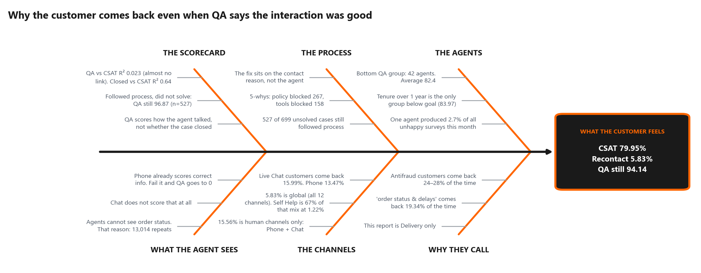
DiDi
Why customers contact us again even when QA is green
30 / 35
Six-factor Fishbone (Ishikawa) root-cause synthesis
Standard QA measures process execution (94.14), while CSAT measures issue resolution (79.95%), resulting in a complete metric disconnect ($R^2 = 0.023$). Because 75.4% of unclosed cases (527/699) strictly adhered to guidelines, non-resolution is driven by policy and tooling boundaries—not frontline agent behavior. Operational priority must shift from coaching agent etiquette to re-engineering unresolvable contact reasons.
Core Strategic Takeaway:
DiDi Global, CX Service Operations | Confidential. Internal use only

Slide 31
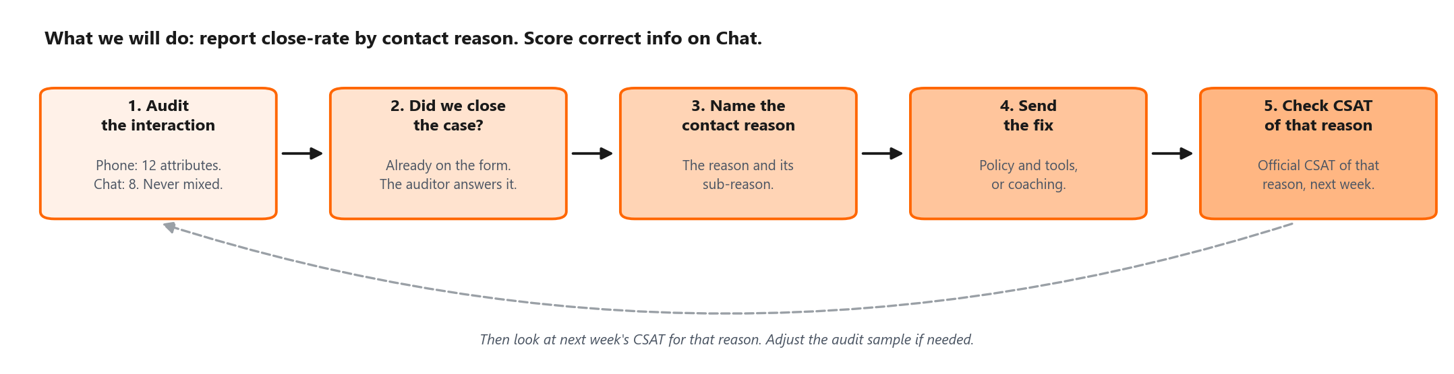
DiDi
What we will do next
31 / 35
Connect QA with the customer outcome
What changes
How we will know it worked
Report auditor closure next to QA, by channel and contact reason (not FCR). Phone closes 9 of 10 assessed (87.9%); Chat 6 of 10 (63.0%). Green if 70%+ closure and 85%+ CSAT.
Measure
Today
Target
Horizon
Assign each improvement to the relevant contact reason. The Dissatisfaction_Owner field only appears in about 4% of audits, so it should not be used as the primary ownership map.
QA vs CSAT (R²)
R² 0.02
R² 0.25 or above
2 quarters
Close-rate vs CSAT (R²)
R² 0.64
Keep 0.50 or above
ongoing
This month: correct Pareto defects we already score (Phone time management and complete information; Chat greeting, attitude, availability). That is operational, not a form change.
CSAT
79.95%
85.0%
2 quarters
Separately, add Chat correct-information as a critical so the scorecard stops inflating (Chat QA would read 80.14). That does not lift CSAT. Track CSAT on targeted contact reasons.
Recontact (human: Phone + Chat)
15.56%
10.0%
1 quarter
Auditor close rate (Phone / Chat)
87.9% / 63.0%
90% / 75%
1 quarter
DiDi Global, CX Service Operations | Confidential. Internal use only

Slide 32
32 / 35
06
Action plans
What must change. Who owns it. When it lands.
DiDi

Slide 33
DiDi
Action plan by Business Type
33 / 35
Delivery is the only line of business in the data. Plans are cut by Business Type.
Business Type
Evidence
What must change
Who
When
Problem severity
Food
CSAT 80.74% on 46,071 surveys; order-status family is 32.2% of unsatisfied surveys and repeats at 19.34%. Chat closes 6 of 10: ETA, not headcount.
Add a live courier ETA to the agent console so customers receive a verifiable status.
CX Ops + Product
30 Jun
Critical
Full Service
CSAT 79.67%, lowest volume line. Undelivered full-service is QA 68.2 (n=49) and the QA fail-volume leader (37 of 518 fails).
Give Phone agents limited same-call refund authority for eligible undelivered orders. Phone already closes 9 of 10; this attacks the remaining 1 and the Chat refund pile.
CX Ops + Finance
15 Jul
Critical
Market Place
CSAT 80.34% on 3,489 surveys; worst Phone QA reason (47.5) but on only 4 audits
Define a clear merchant-escalation SLA and script for “completed but not received.” Low confidence: run 20+ audits on this reason before committing merchant-side resources
Merchant Ops
15 Jul
High
All Business Types
Refund or compensation not received is 18.8% of negative verbatims. Refund status is 7.6% of unsatisfied surveys (1,181).
Send an automatic notification whenever refund status changes
Product + CX Ops
31 Jul
High
Data quality
'Other' Business Type holds 558 surveys at 26.5% CSAT
Fix the CR-to-Business-Type mapping so detractors are correctly classified
CX Analytics
20 Jun
Moderate
Severity rates how large the gap is. None of these actions has started yet.
Market Place. That case rests on a contact reason with only 4 audits, the same low-volume reason flagged as unreliable in the Phone QA section. Validate with more audits before committing resources.
DiDi Global, CX Service Operations | Confidential. Internal use only
DiDi Global, CX Service Operations | Confidential. Internal use only · Owners are role-level; names to be confirmed with CX Leadership at the weekly review.

Slide 34
DiDi
Action plan by channel, people and governance
34 / 35
Owner, deadline and the severity of the problem behind each action
Scope
What must change
Why now
Who
When
Problem severity
Phone
Increase Phone QA coverage to at least 30%
Phone is 14.4% of audits and the only channel below goal
QA Lead
13 Jun
Critical
Phone
Coach Time Management: system-check script at start; escalate if no data in 2 minutes
64.3% of Phone defects, 133 fails
Supervisors
27 Jun
High
People
Run weekly coaching for the 42 QA-Q4 agents, starting with the five teams with the highest concentration
26 agents below the QA goal; Supervisor 13 alone carries three
Supervisors + QA Lead
20 Jun
High
Live Chat
Add a Chat critical attribute for correct information, aligned with Phone
372 chats did not follow process; 297 still score 100. Current Chat QA: 96.01. Adjusted QA under proposed scoring: 80.14
QA Lead
30 Jun
Critical
Live Chat
Do not add Chat headcount. Chat closes 6 of 10 assessed (63.0%); 499 of 658 unresolved followed process. Order status and refunds will not close with more agents.
Chat abandon 15.6% vs Phone 4.8%. Live Chat generates 67.2% of every repeat contact.
CX Ops
15 Jul
Critical
QA governance
Report auditor closure weekly by channel (Phone 87.9%, Chat 63.0%) and assign an owner to every unclosed case. Not FCR.
499 Chat and 28 Phone unresolved cases followed process. The field is already on the form (QA 96.87).
QA Lead + CX Head
31 Jul
Critical
QA governance
Report QA and recontact weekly by channel, including Phone+Chat vs the official global rate
Blended figures hid a 13-point channel gap and a 10-point recontact gap
CX Analytics
13 Jun
Moderate
Tagged actions — one action can serve two KPIs. Unique list is on the matrix.
Fix what we measure vs what the customer gets
QA
94.14
8 actions
QA Lead
Phone closes 9 of 10 assessed; Chat 6 of 10. Do not staff Chat for that gap: most unresolved chats followed process. ETA and refunds change the outcome. Pareto coaching and the Chat critical change the scorecard. Do not mix those.
CSAT
79.95%
6 actions
CX Ops
Recontact
5.83%
4 actions
CX Ops
DiDi Global, CX Service Operations | Confidential. Internal use only

Slide 35
DiDi
The recommendation
35 / 35
Process compliance looks healthy. Customer outcome does not.
What this month is telling us
Our operation looks healthy when we measure agent process compliance (QA 94.14), but the customer outcome tells a different story. Blended CSAT is 79.95% against 85% (Phone 86.3%, Chat 77.6%), and human-channel recontact is 15.56%, nearly three times the 5.44% goal. The largest gaps sit in contact reasons where agents cannot close the case: policy, tooling, or no visibility. The priority is not simply more coaching. Measure resolution. Phone closes 9 of 10 assessed contacts; Chat 6 of 10. Correct the scored defects this month. Fix the QA scoring gaps. Give agents a way to close the highest-volume failure reasons.
Three things to do
Measure resolution
Fix scored defects, then the form
Let agents close the case
Put % closed next to QA, by channel and contact reason. Phone closes 9 of 10 assessed (87.9%); Chat 6 of 10 (63.0%). Not FCR. Closure is strongly associated with CSAT. Close-rate vs CSAT: R² 0.64.
This month: Phone time management and complete information; Chat greeting, attitude, availability. Then close the Chat scoring gap (current 96.01 vs 80.14 if process-fails scored 0). The second number is measurement, not CSAT.
Policy, tools, and visibility on the highest-volume failure reasons. Phone already closes 9 of 10 assessed; Chat leaves 4 of 10 open, mostly after following process. The priority is that constraint, not Chat coaching volume.
DiDi Global, CX Service Operations | Confidential. Internal use only

